Slide 1
Agile Quality Management
Lecturer: Ngo Huy Bien
Software Engineering Department
Faculty of Information Technology
VNUHCM - University of Science
Ho Chi Minh City, Vietnam
nhbien@fit.hcmus.edu.vn

Slide 2

Objectives
To improve your software quality.
To improve your team collaboration quality.

Slide 3

Contents
Agile quality assurance techniques
Documentation
Retrospectives

Slide 4

References
James Shore and Shane Warden (2008). The Art of Agile Development. O'Reilly.
Esther Derby and Diana Larsen (2006). Agile Retrospectives: Making Good Teams Great. Pragmatic Bookshelf.

Slide 5
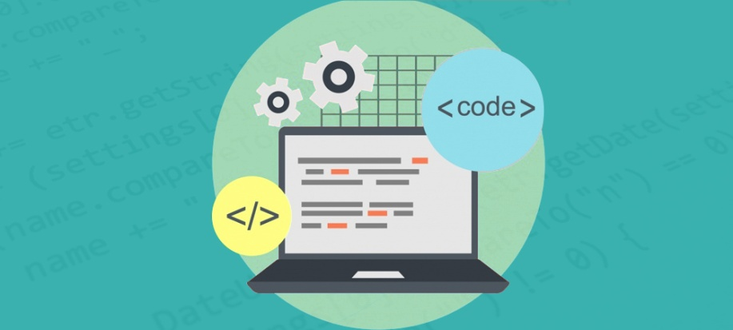

1. Create Coding Standards [1]
Coding standards and conventions
Formatting
Tools and IDE
File and directory layout
Error handling
Approach to events
Logging
Don’t allow coding standards to become a divisive issue for your team.
Refer to 03. Coding Standards.pptx for details.

Slide 6
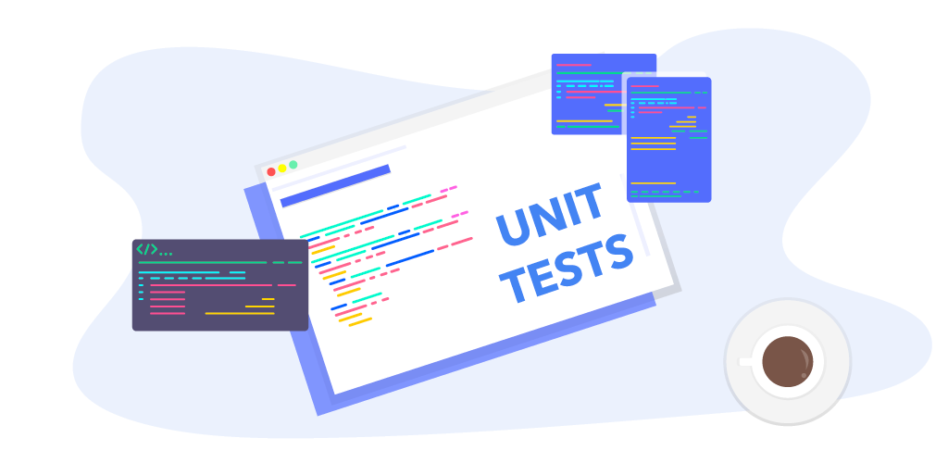
2. Create Unit Tests
Refer to Software Construction: 08. Unit Testing.pptx for details.

Slide 7
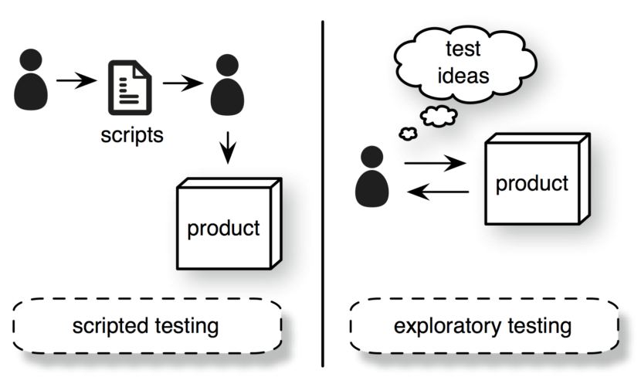
3. Create Exploratory Test Scenarios
Finding bugs based on common types of faults: zero, one, many, too big, too small, create, read, update, delete, data types

Slide 8
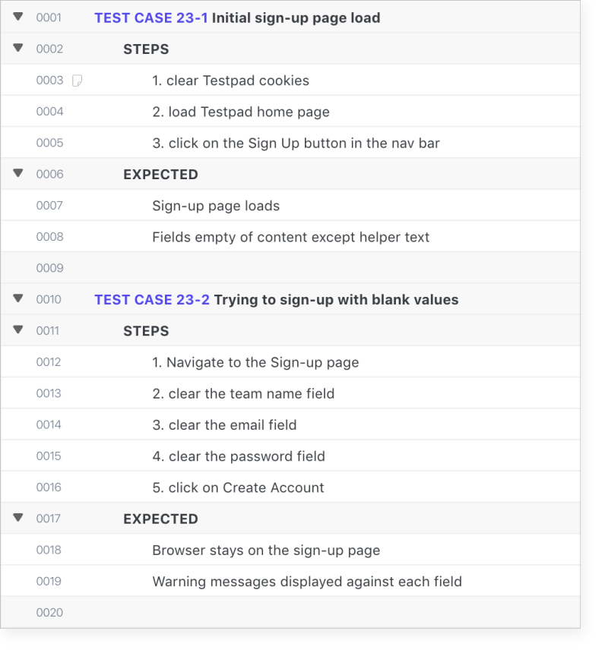
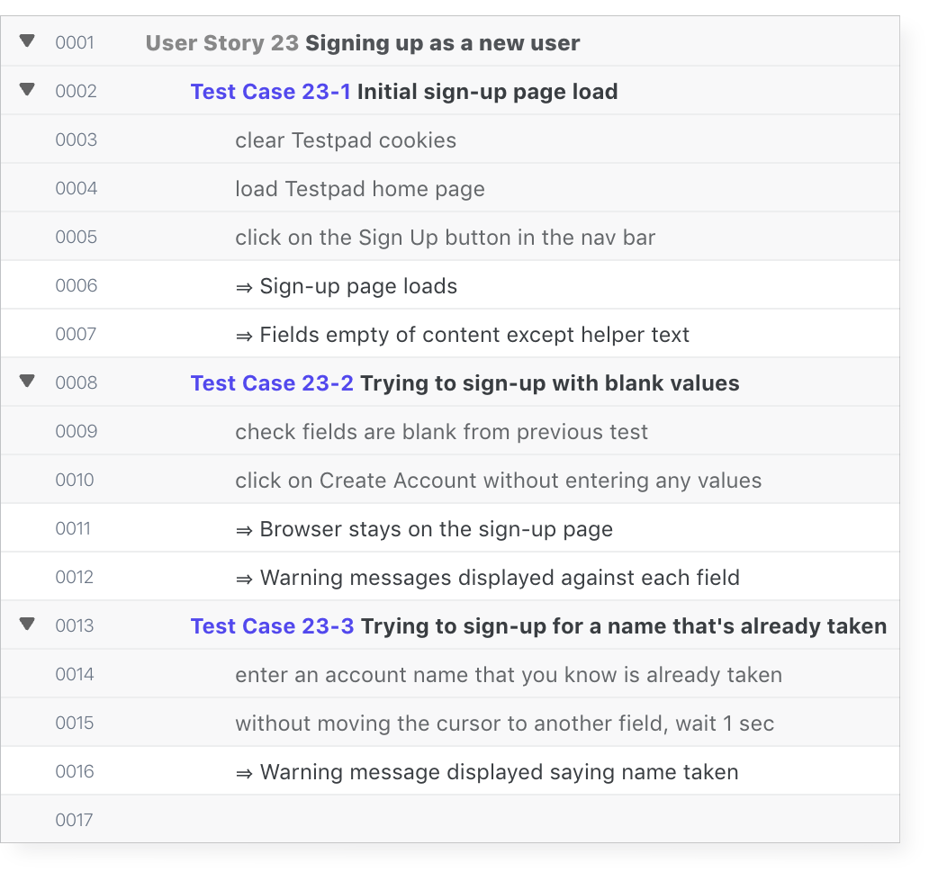
Example Exploratory Test Scenarios
https://ontestpad.com/signup
A more compact version

Slide 9

4. Create End-to-End Unit Tests
https://www.cypress.io/

Slide 10
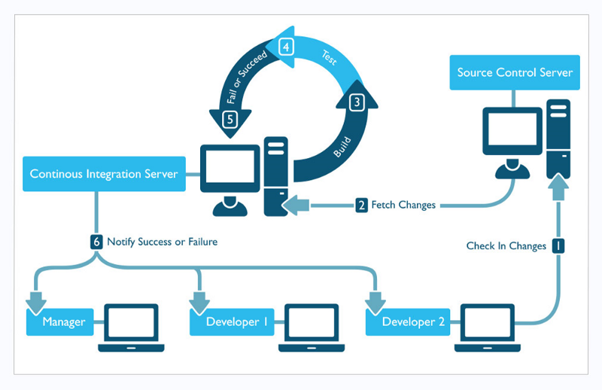
5. Integrate Unit Tests with CI/CD/DevOps System

Slide 11

6. Perform Code Inspection

Slide 12

Simple Design
Appropriate for the intended audience.
It doesn’t matter how brilliant and elegant a piece of design is; if the people who need to work with it don’t understand it, it isn’t simple for them.
Communicative.
Every idea that needs to be communicated is represented in the system. Like words in a vocabulary, the elements of the system communicate to future readers.
Factored.
Duplication of logic or structure makes code hard to understand and modify.
Minimal.
Within the above three constraints, the system should have the fewest elements possible. Fewer elements means less to test, document, and communicate.

Slide 13

Code Smells & Refactoring
Divergent Change occurs when unrelated changes affect the same class.
Shotgun Surgery is just the opposite: it occurs when you have to modify multiple classes to support changes to a single idea.
Time Dependencies occur when a class’ methods must be called in a specific order. Time Dependencies often indicate an encapsulation problem. Rather than managing its state itself, the class expects its callers to manage some of its state.
Half-Baked Objects are a special case of Time Dependency: they must first be constructed, then initialized with a method call, then used.

Slide 14

7. Create Documentation
The team does document some things, such as the vision statement and story cards, but these act more as reminders than as formal documentation.
Some projects need to produce specific kinds of documentation to provide business value.
Examples include user manuals, comprehensive API reference documentation, and reports. Create, estimate, and prioritize stories for product documentation.
Handoff documentation: create a small set of documents recording big decisions and information.
Your goal is to summarize the most important information you’ve learned while creating the software—the kind of information necessary to sustain and maintain the project.

Slide 15

8. Ask Customer to Perform Tests
Problem-solution, business cases, goals.
Customer tests are for communication.
Customer feedback report.

Slide 16
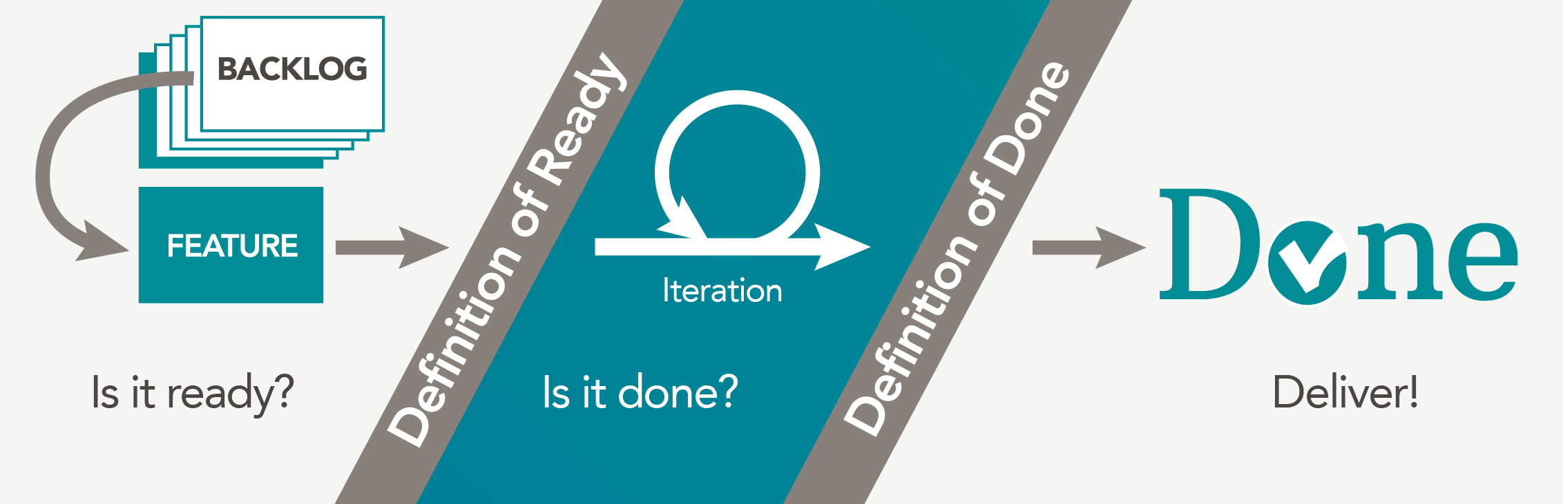
9. Create “Definition of Done”
We’re done when we’re production-ready.

Slide 17


Slide 18

1a. Conduct a Retrospective Meeting
Set the stage
Regardless of what we discover today, we understand and truly believe that everyone did the best job they could, given what they knew at the time, their skills and abilities, the resources available, and the situation at hand.

Slide 19
1b. Conduct a Retrospective Meeting
Brainstorming
Index cards and pencils
Enjoyable
Same
Less
More
Frustrating
Same
Less
More
Puzzling
Same
Less
More

Slide 20
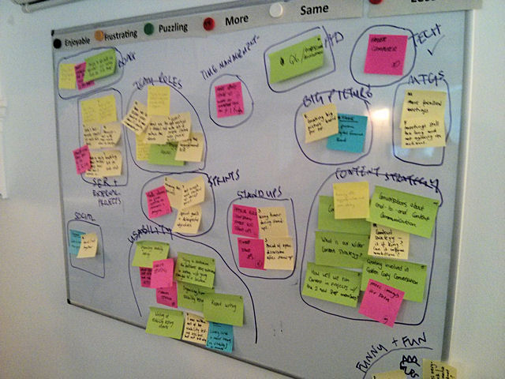
1c. Conduct a Retrospective Meeting
Mute Mapping
Put related cards close together.
Put unrelated cards far apart.
No talking.
Circle the categories.
Read a sampling of cards from each circle and ask the team to name the category.

Slide 21
1d. Conduct a Retrospective Meeting
Retrospective Objective
Give each person five votes. Participants can put all their votes on one category if they wish, or spread their votes amongst several categories.
After the voting ends, one category should be the clear winner. If not, don’t spend too much time; flip a coin or something.
Come up with options for improving it.
Apply your root-cause analysis skills.
Read the cards in the category again, then brainstorm some ideas.
Create user stories for action items.

Slide 22
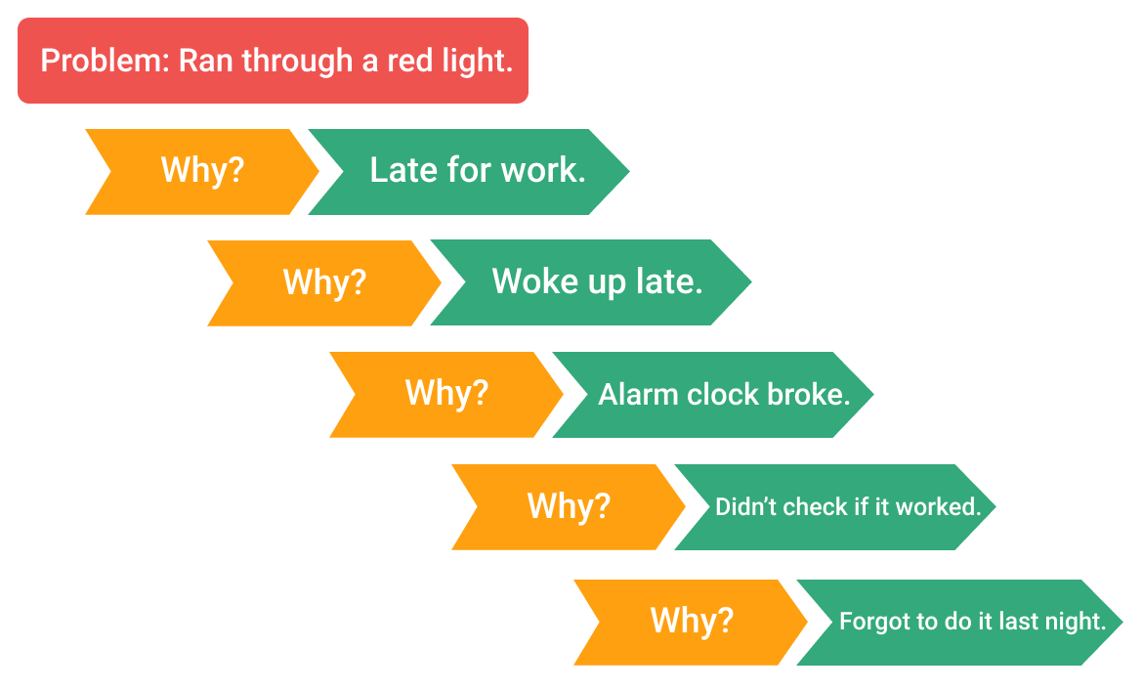
2. Apply Five Whys

Slide 23
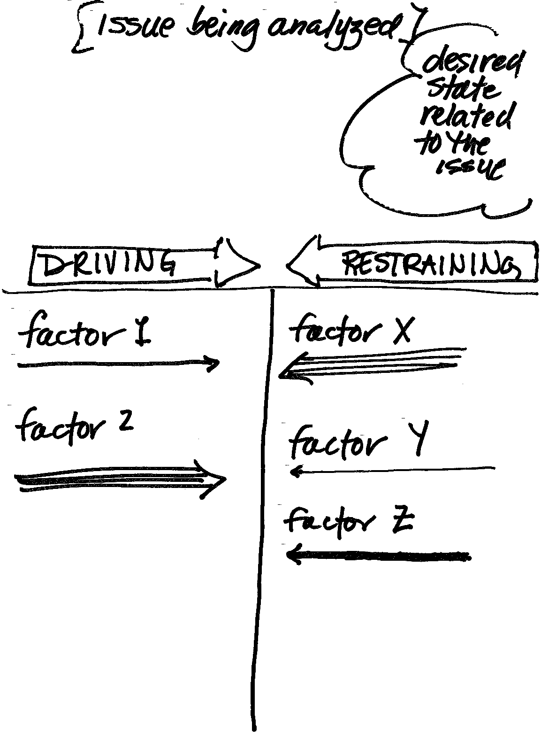
3. Apply Force Field Analysis [2]

Slide 24
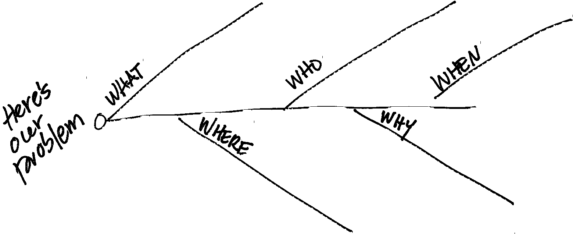
4. Apply Fishbone

Slide 25

Thank You & See You Again

